Slide 1



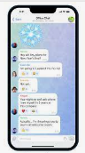










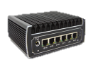
Infra Connection Monitor Hub
User
Public IP
Web-Browser
Telegram
SUTD, Singtel, gov.sg
Public network
Hub server
SoC network
Http:3000
tcp:8086
Telegram client
PingClient
Server cluster
Filtered data
HTTP(POST):80
Ajax page:5000
All data
Ping
Connection map module
Summarized data
Data manager
Ping
Alert raise module
Exception data
server
switch
Alert History DB
UDP:3001
COM3-MPH
Cyber event scenario
User PC
PingClient
CIDEX- SUTD-Cluster
CIDEX-CR1-Cluster
Ping
Ping
Event server
gateway
vCenter
Internet
Ping
VPN tunnel
Ping
Local storage [text log file]
Gateway and switch
VPN tunnel

Slide 2

NCL-CIDEX Connection Monitor Hub
Oversea IP
BBC.CO.UK
SG IP
Web-Browser
ssh -L 127.0.0.1:4000:127.0.0.1:3000 yc@172.26.191.95
SUTD, Singtel, gov.sg
Public network
Network Connection hub
SoC network
NCL-server
Ping
Ping
Http:3000
tcp:8086
COM3-MPH
Ajax:5000
UDP:3001
Connection map module
Data manager
PingClient
alert raise module
Alert History DB
Local storage [text log file]
CIDEX- SUTD-Cluster
CIDEX-CR1-Cluster
Ping
gateway
vCenter
VPN tunnel
Ping
VPN tunnel

Slide 3
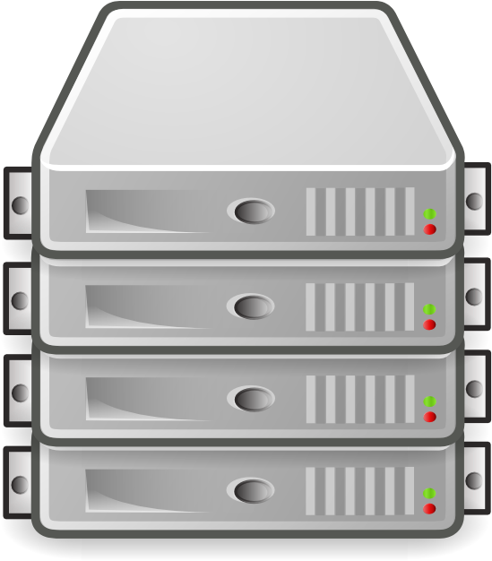

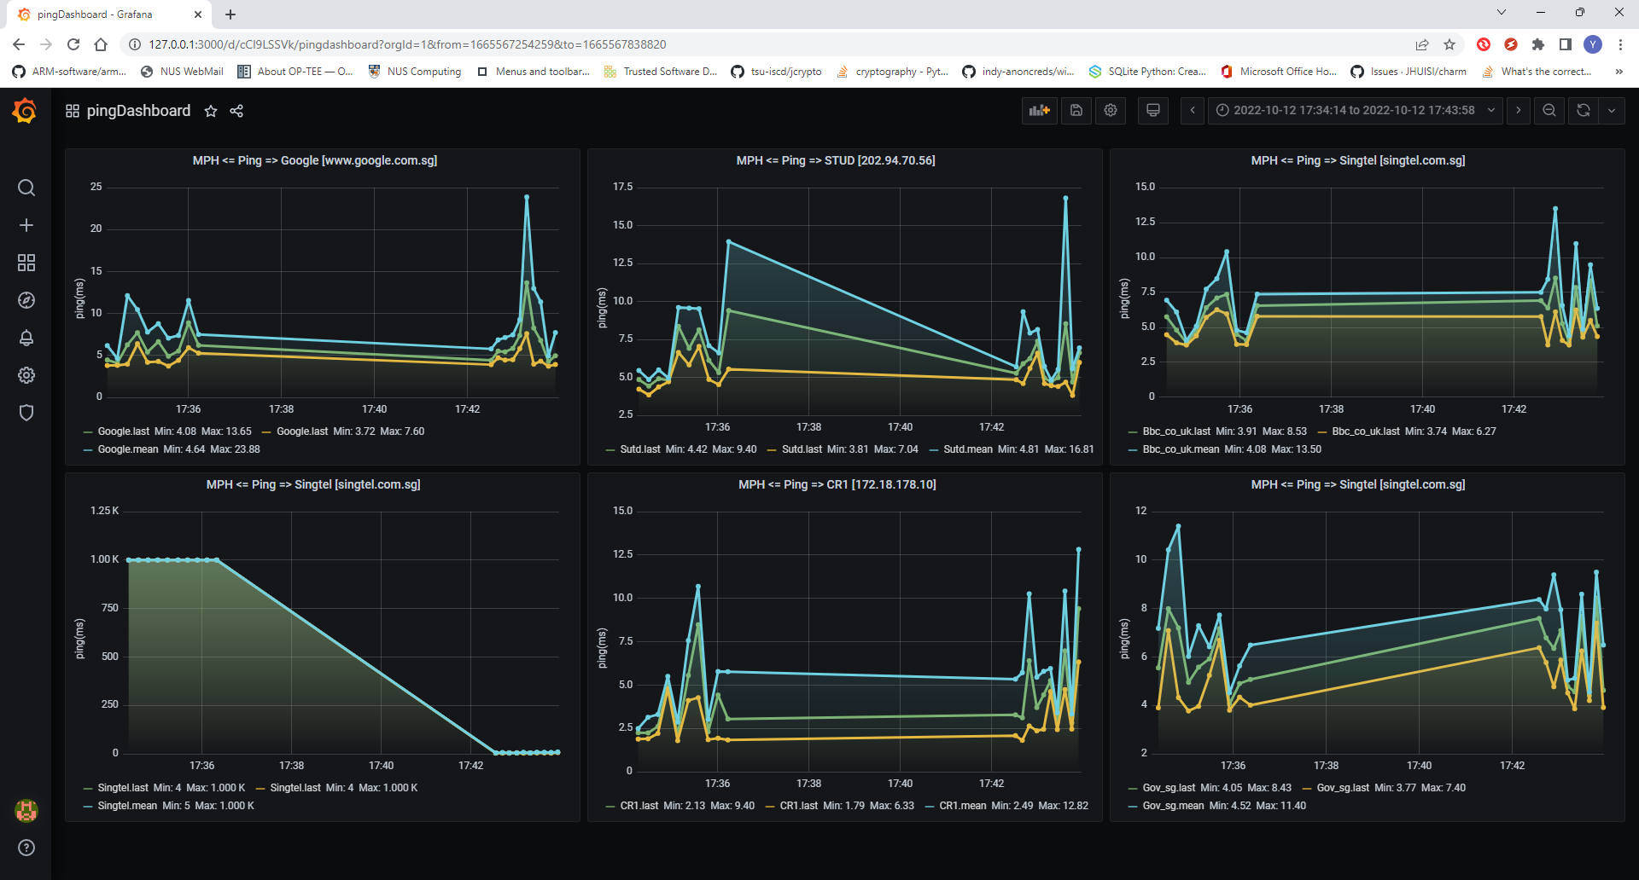
Cluster internal network
Cluster internal network
Internet
Internet
Connection monitor hub
Monitor dashboard
Cluster internal network
Ping request
Report msg

Slide 4
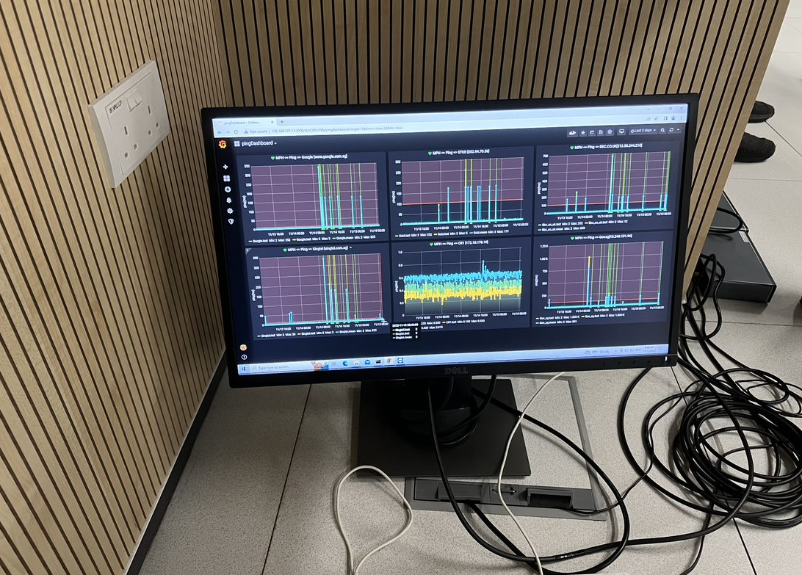
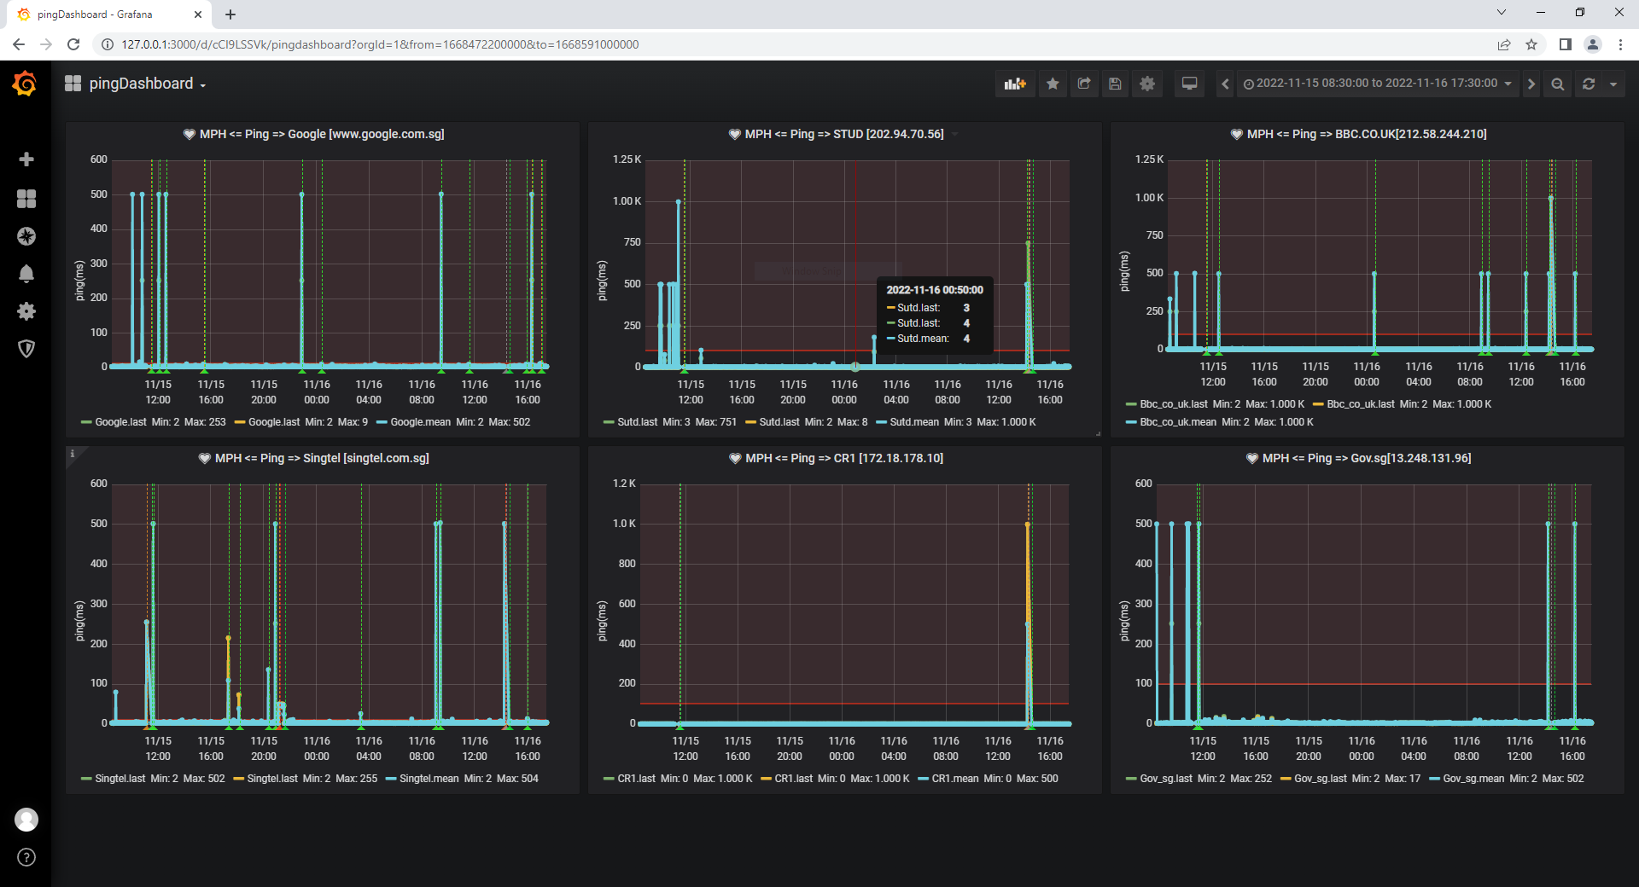
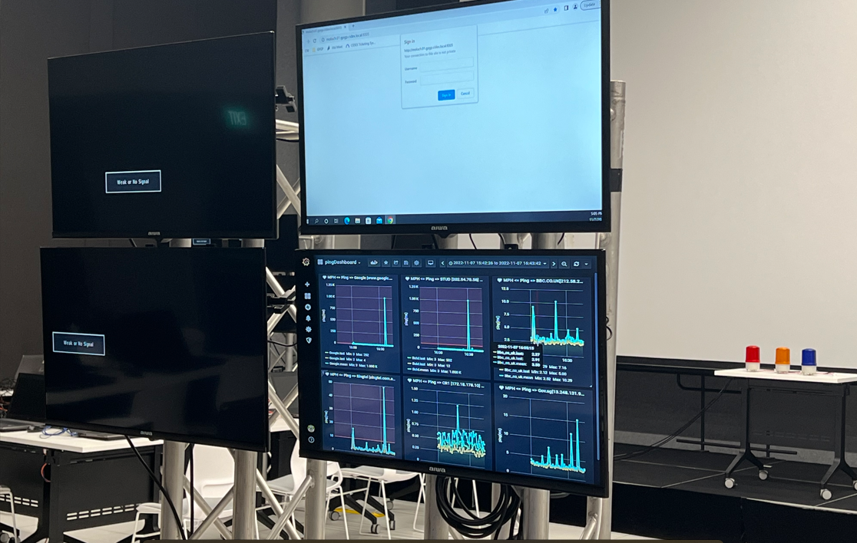
Use Case 1: CIDeX event main venue network monitor
Event day network ping latency monitor:
Monitor time: 15/11/2022 8:30 am – 16/11/2022 6:30pm [34hours]
Monitor peers: 6 peers [4 public , 1 NUS internal, 1 VPN peer in SUTD]
Ping Client Config: Ping each peer 5 times/min, report to hub every 1min.
Monitor hub alert threshold: 100 ms.
Telegram-bot: update in Ncl-infra channel every 5min with 1 summary report.
Entire ping latency chart during the 34 hours:
Monitor server config:
Running on backup DHCP server[192.168.127.11] , dashboard is accessible by any laptop/pc used in the event (connected to MPH network).

Slide 5
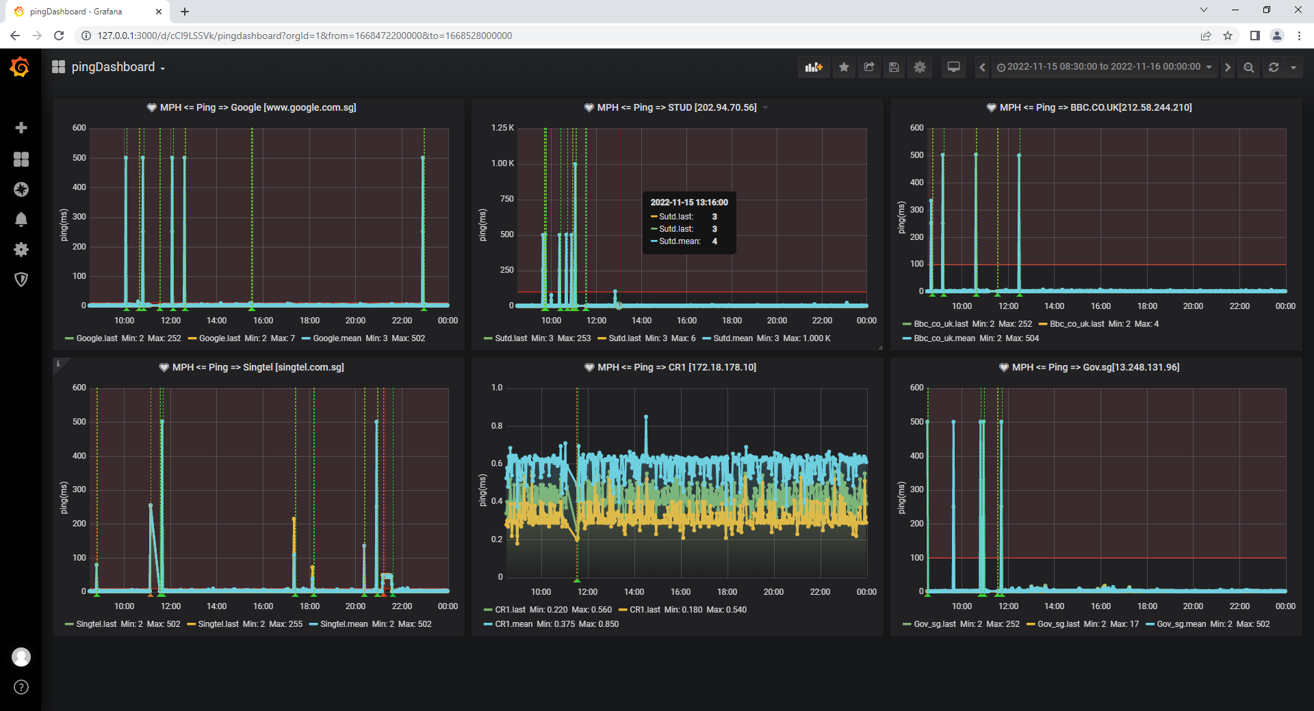
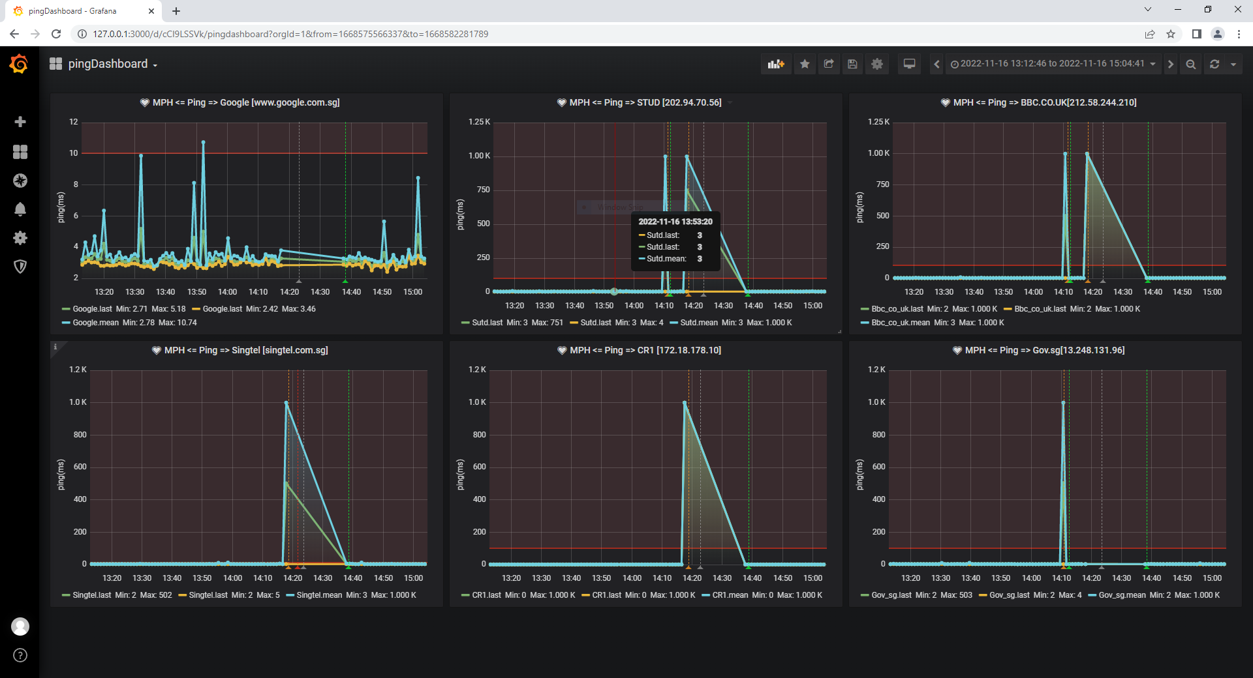
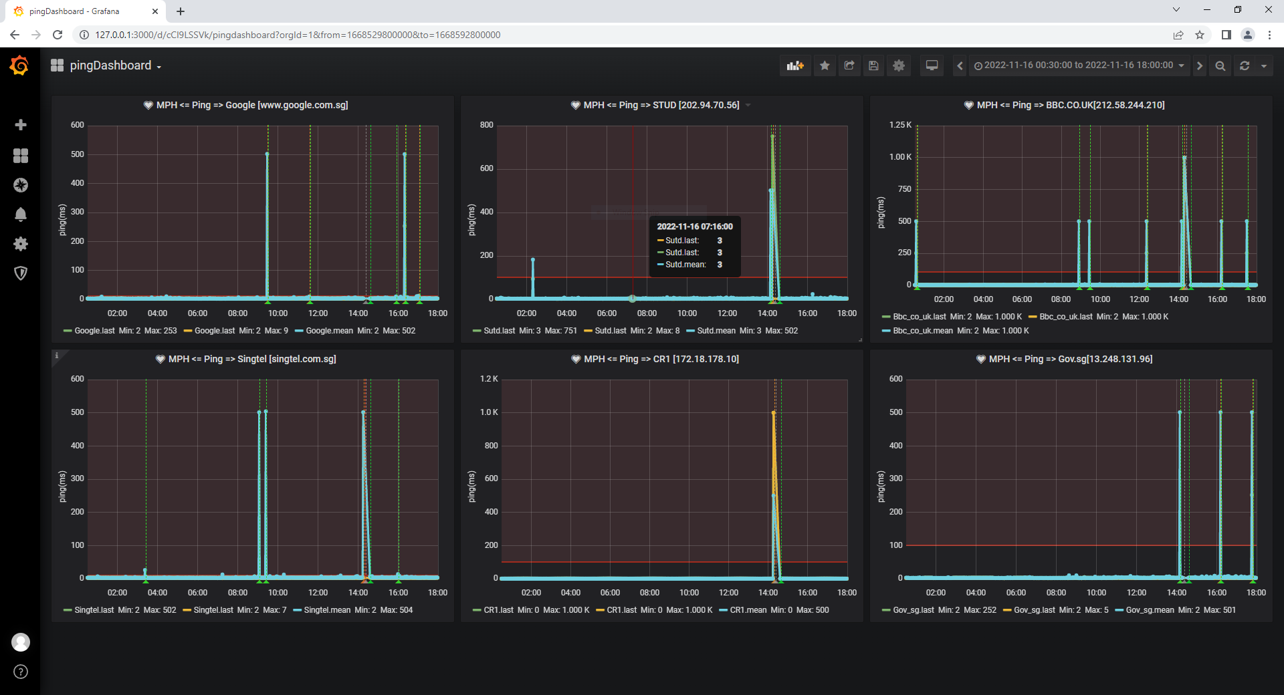
Use Case 1: CIDeX event main venue network monitor [result]
Event day-1 [15/11/2022] entire ping latency chart:
Event monitor result:
Ping client: 900KB raw ping record [text format].
Monitor hub: 600K DB raw + avg data, 1 network interrupt detect and reported.
Telegram-bot: 197 avg ping report in the channel.
Network interrupt [16/11/2022] detection result:
Event day-2 [16/11/2022] entire ping latency chart:
Network interrupt time:
Started at 2:16 and started to recovered at 2:20.

Slide 6
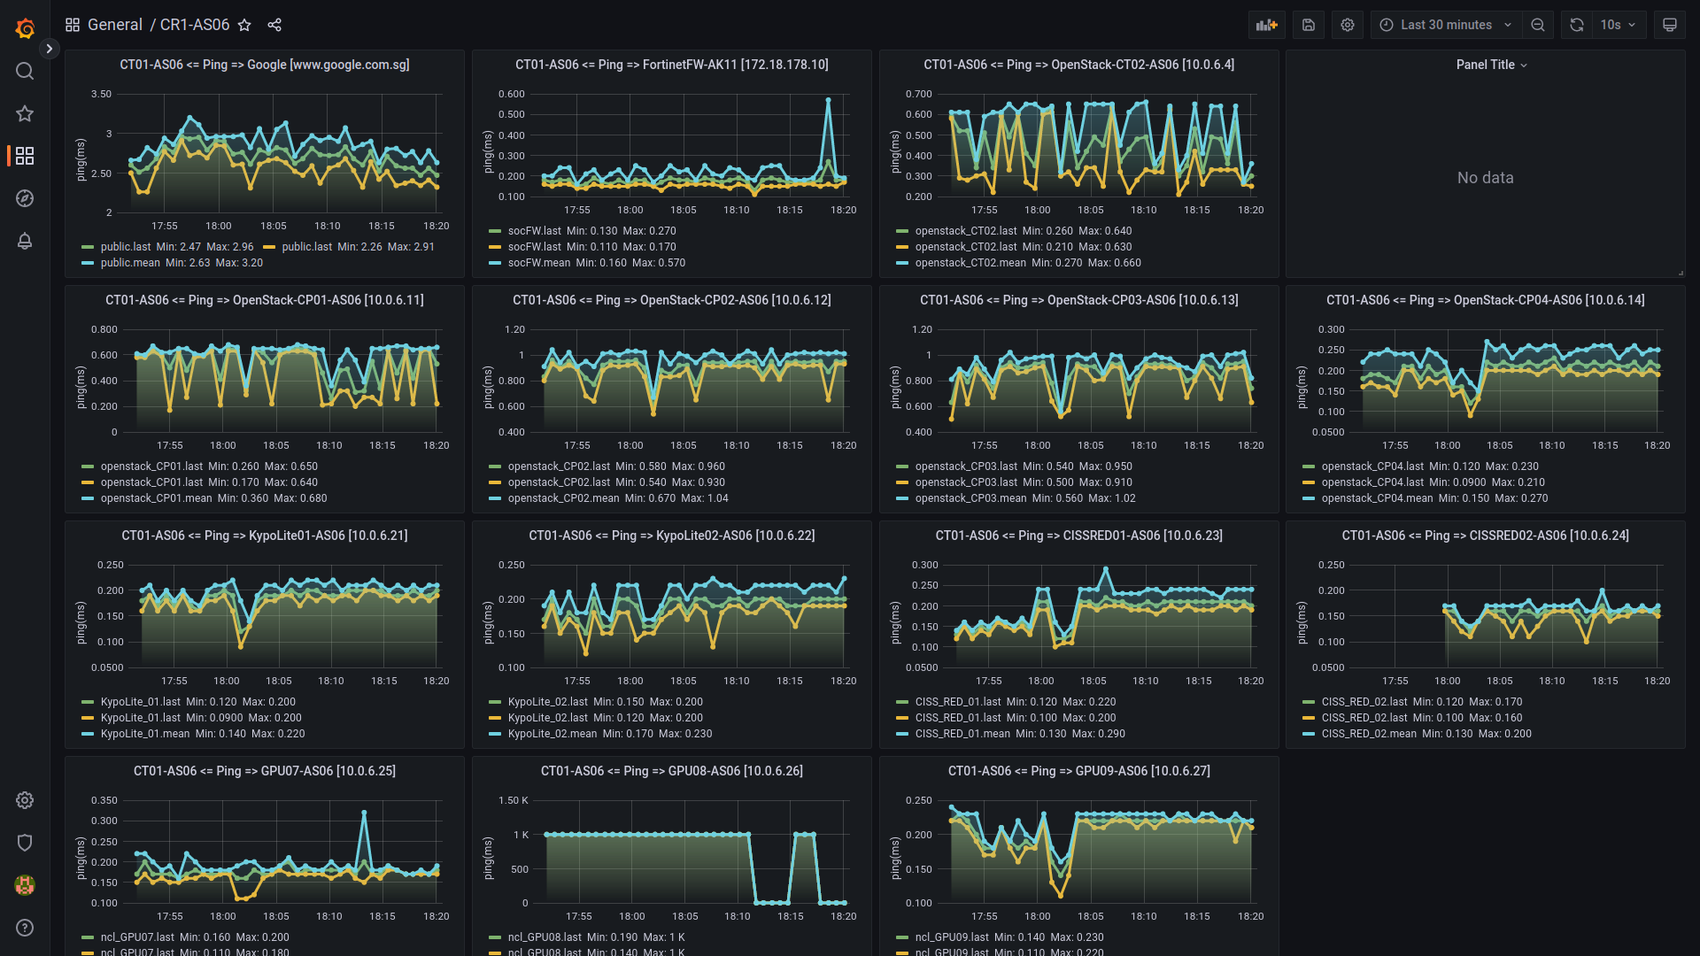
Use Case 2: NCL CR1 cluster monitor
NCL rack AS06 connection dashboard:
Access link:
https://172.26.190.93:4000
Login:
Viewer/viewer
Connection monitored peers:
Public peer:
"public": "www.google.com.sg",
SoC peer:
"socFW": "172.18.178.10",
Cluster internal peer:
"openstack_CT02": "10.0.6.2", "openstack_CP01": "10.0.6.11", "openstack_CP02": "10.0.6.12", "openstack_CP03": "10.0.6.13", "openstack_CP04": "10.0.6.20", "KypoLite_01": "10.0.6.21", "KypoLite_02": "10.0.6.22", "CISS_RED_01": "10.0.6.23", "CISS_RED_02": "10.0.6.24", "ncl_GPU07": "10.0.6.25", "ncl_GPU08": "10.0.6.26", "ncl_GPU09": "10.0.6.27",
Client Config:
3 ping every 30 sec.
Report to hub every 3 mins

